Slide 1
SPAM DETECTION USING MACHINE LEARNING
(FIRST REVIEW)
PRESENTED By :
GOWTHAM RAJ (21AI012)
JAGADEESHWARAN (21AI016)
JASSIM USMAN (21AI017)
Guided By :
Mrs.SENTHAMARAI.M
TEAM NO. 11
17AIC02 – INTRODUCTION TO ARTIFICIAL INTELLIGENCE

Slide 2
Abstract
Email Spam has become a major problem nowadays, with Rapid growth of internet users, Email spams is also increasing.
People are using them for illegal and unethical conducts, phishing and fraud. Sending malicious link through spam emails which can harm our system and can also seek in into your system.
Creating a fake profile and email account is much easy for the spammers, they pretend like a genuine person in their spam emails, these spammers target those peoples who are not aware about these frauds.
So, it is needed to Identify those spam mails which are fraud, this project will identify those spam by using techniques of machine learning, this paper will discuss the machine learning algorithms and apply all these algorithm on our data sets and best algorithm is selected for the email spam detection having best precision and accuracy.

Slide 3
Project Idea:
spam filtering is a filtering system that implements a set of rules and works with that set of protocols as a classifier.
In the first step, content filters are implemented and use Machine learning techniques to figure out the spam by using the csv file format of excel sheet
Then copy the email or messages and paste it in the website
The Website that we are made with html to test that the message is spam or not spam
In this project we use flask library concepts to to run this project in the website with specific local ip address

Slide 4
Languages used:
HTML - HYPER TEXT MARKUP LANGUAGE(index.html)
CSS - CASCADING STYLE SHEETS(style.css)
PYTHON (NORMAL PYTHON - app .py)
JUPYTER NOTEBOOK PYTHON - Trained Dataset Model.jpynb

Slide 5
Modules:
Dataset training module (created using Jupyter Notebook(ipython)
Webpage desining module(created using HTML and CSS)
Backend(flask) module(created using Python)
Testing module(Testing the whole project)

Slide 6
Module Description:
DATASET TRANING MODULE (Completed):
It is an Backend Module.In this module,First we take the spam message dataset from kaggle.com which is an data science company who have N number of datasets.
After the dataset get downloaded open jupyter notebook and set the project folder directory and create a new ipython file.
In the ipython file first import pandas library to manipulate the dataset. And read the csv file .
After readed the dataset import the sklearn library to train the dataset ,from sklearn use MultinomialNB naive bayes package to classifiers the spam and not spam messages.
After the dataset get trained dump the model into pickle file like(spam_model.pkl)using Joblib library and dump() method.

Slide 7
Module Description:
WEBPAGE DESIGNING MODULE (Inprogress) :
It is an Frontend Module . In this module we create an web page using HTML & CSS.
Initially the top heading is created and an text field is to read the message form the user.
After we create an button to run spam detection module.
And we added two different sounds for spam and not spam messages.
In CSS we add style to the each and every part of our webpage for heading, text field, button, images.

Slide 8
Module Description:
BACKEND FLASK MODULE(Inprogress):-
Initially imported the flask module to connect the python source to webpage.
After imported the pandas and numpy libraries to analyze and manipulate the dataset. Then import the joblib library to access the trained model .
Next check posted message with dataset and using if-else statements to print the message is spam or not.
After the code get completed save the python code as “app.py”.

Slide 9
Module Description:
TESTING MODULE(Not started):
First run the app.py it will generate an IP address.
Then copy the IP address and paste it in any web browser.
After paste the IP address it show the spam detection webpage.
Then paste the message in the text field that you want to check it.
After it check the message with the dataset and report it is spam or not and also play different sounds.
After the spam detection process completed come to app.py shell and press “ctrl+q” Quit the webpage.

Slide 10
1.Dataset training module : Done by JAGADEESWARAN VP
2.Webpage desining module : Done by JASSIM USMAN.M
3.Backend(flask) module : Done by GOWTHAM RAJ.B
MODULES DONE BY EACH MEMBERS:

Slide 11
Our project detect, unwanted, and virus-infested email and messages(called spam) so our project use to detect this like spam messages and links and the people was aware of this spam Messages in email and form Other Source
Application of the Project:

Slide 12
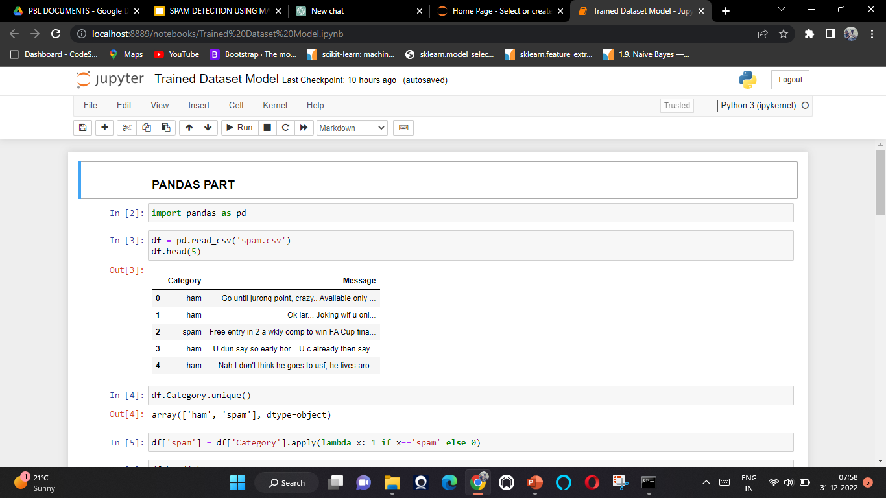
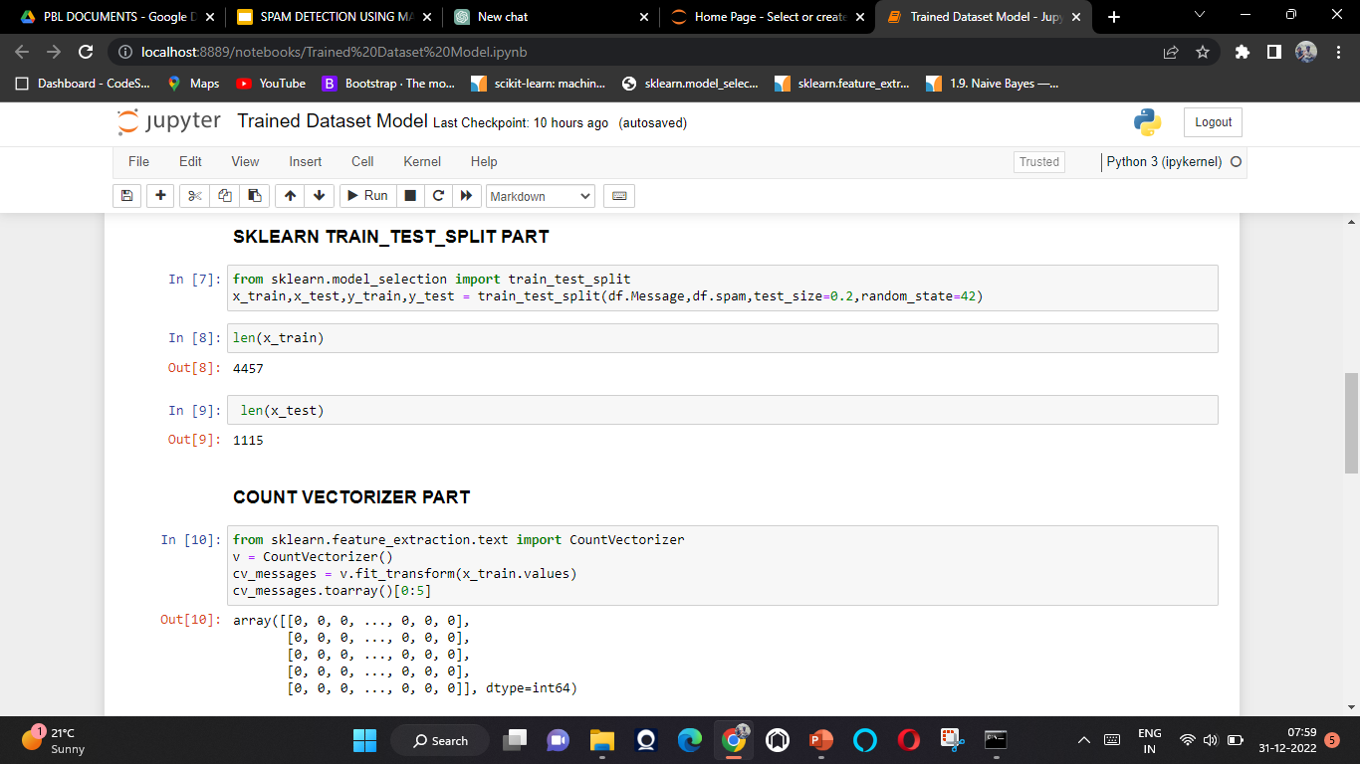
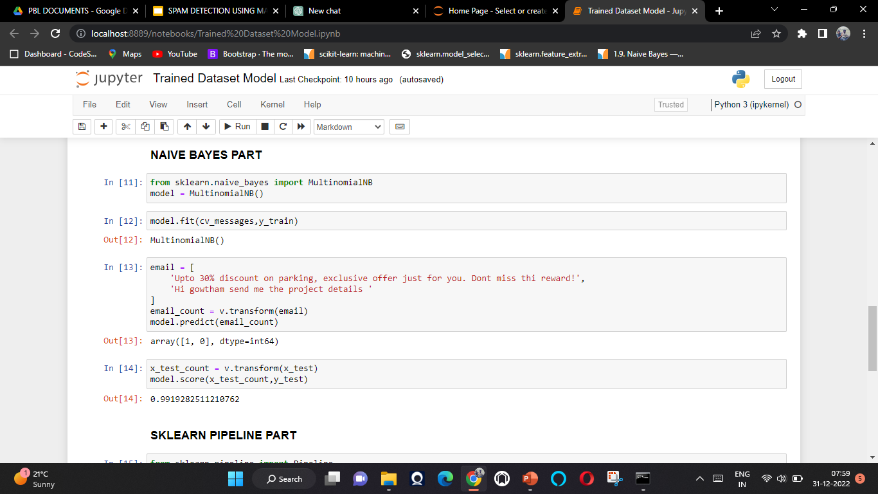
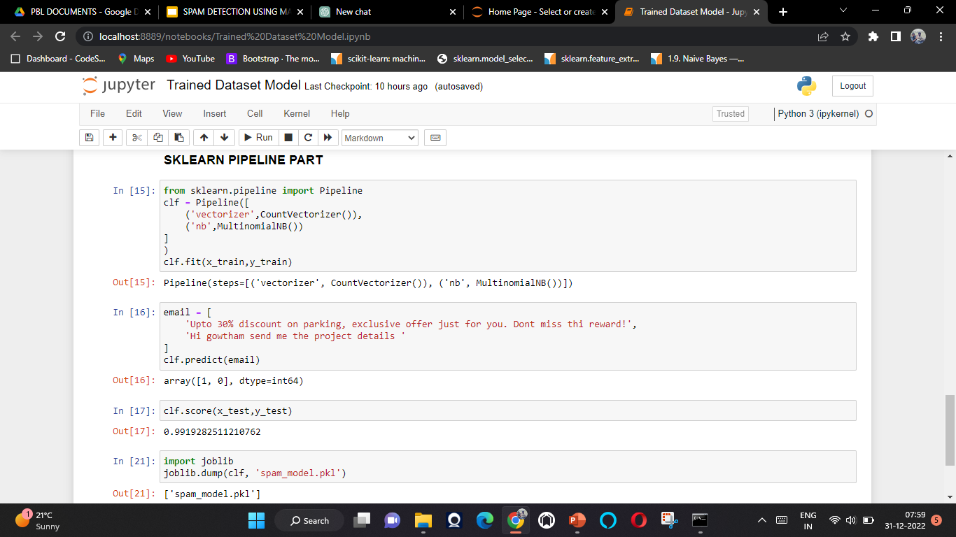
Screen Shots:

Slide 13
Conclusion:
Spam emails and Messages is one of the most demanding and troublesome internet issues in today’s world of communication and technology.
It is almost impossible to think about e-mail and message without considering the issue of spam. Spammers by generating spam mails are misusing this communication facility and thus affecting organisations and many email users.
Our Project have now Used to detect and filter out spam using our website and phishing emails and messages

Slide 14


